Slide 1
LIF 101 Lecture 9 of 13
5th March 2016
Application of Recombinant DNA Technology

Slide 2

CHAPTER 8
Applications of Recombinant DNA Technology
These slides are sourced and further edited from:
By Peter J. Russell

Slide 3
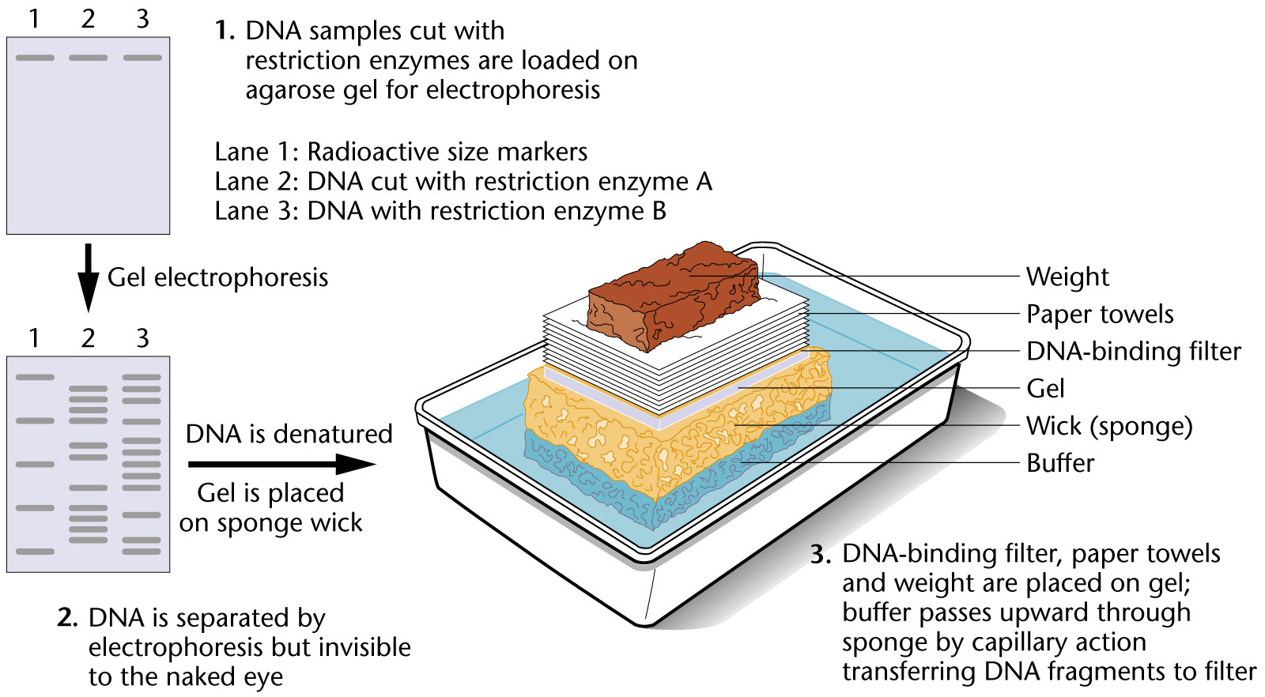
A short technical background:
Steps 4 and 5 are shown in the next slides
Southern blot analysis

Slide 4
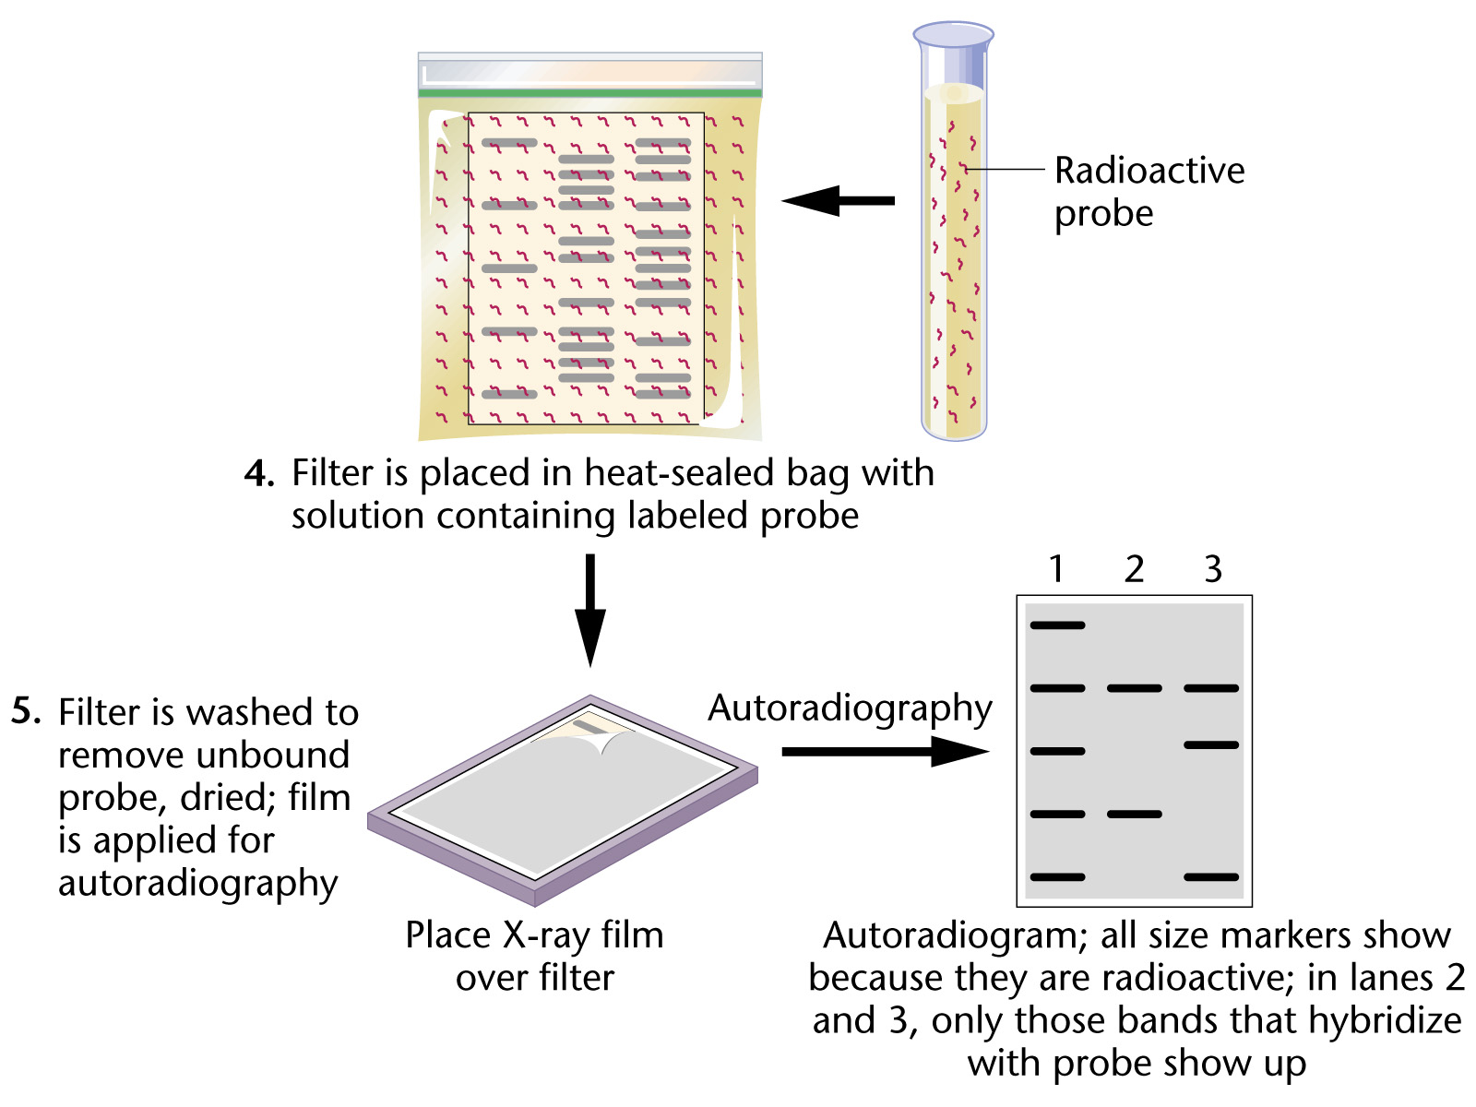
A probe means a comple-mentary piece of single stranded DNA
This us therefore a way to visual desired fragments of DNA from a very complex mix

Slide 5

Concept of DNA Molecular Testing
1. Designing DNA molecular tests requires knowledge of gene mutations that cause a disease, derived from sequencing the gene involved.
2. Often a disease is caused by a variety of mutations, complicating its study. The breast cancer genes BRCA1 and BRCA2 are examples:
  a. Normal BRCA1 and BRCA2 genes control cell growth in breast and ovarian tissue.
  b. Mutations in the BRCA1 and BRCA2 genes can lead to cancer. Hundreds of mutations in these genes have been identified.
  c. Each BRCA1 or BRCA2 mutation confers a different risk of developing cancer, ruling out a single DNA molecular test to assess an individual’s breast cancer risk associated with these genes.
3. Genetic testing reveals the presence of a mutation associated with a genetic disease.
Why this image makes sense here??

Slide 6
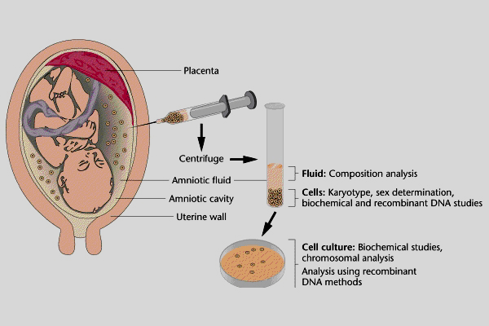
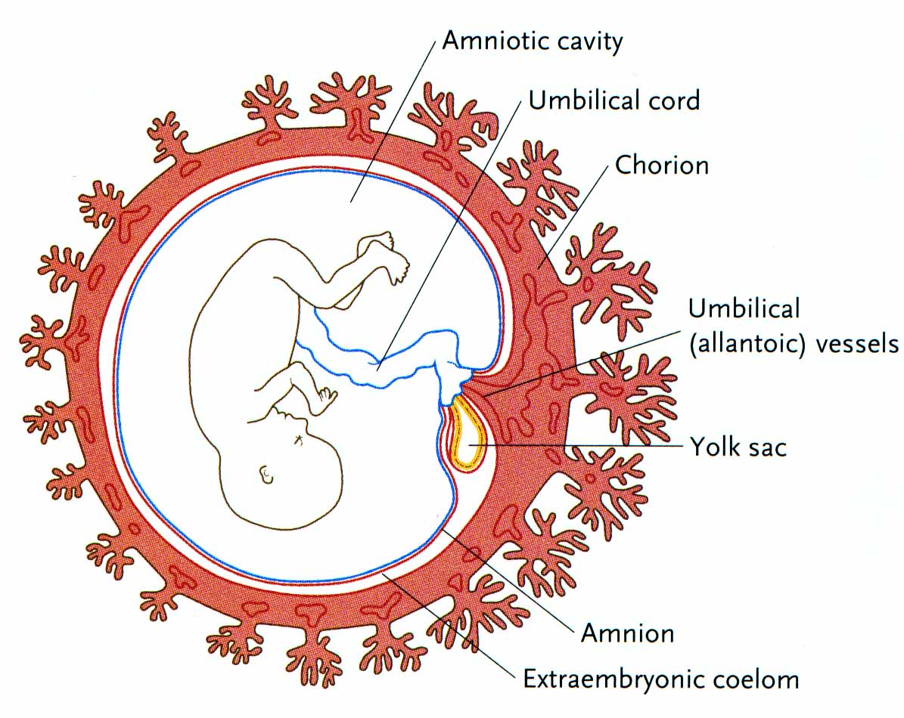
Purposes of Human Genetic Testing
1. Human genetic testing serves three main purposes:
  a. Prenatal diagnosis. B. Newborn screening. C.Carrier (heterozygote) detection.
Prenatal diagnosis uses amniocentesis or chorionic villus sampling to assess risk to the fetus of a genetic disorder by analyzing for a specific mutation, or biochemical or chromosomal abnormalities.
Amniocentesis
Chorionic villus sampling

Slide 7
Examples of DNA Molecular Testing
Testing by restriction fragment length polymorphism (RFLP). RFLPs are associated with many genetic disorders.
Sickle-cell anemia is an example:
  a. A single base-pair change in the β-globin gene results in abnormal hemoglobin, Hb-S, rather than the normal Hb-α. Hb-S molecules cause sickling of red blood cells.
  b. The Hb-S mutation is an AT-to-TA base pair change in the 6th codon of b-globin, resulting in a valine rather than a glutamic acid, and also eliminating a DdeI restriction enzyme site (Figure 8.4 next slides).

Slide 8
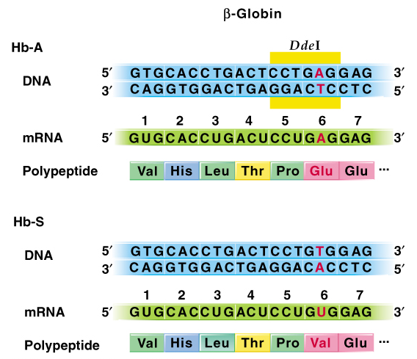
Fig. 8.4 The beginning of the β-globin gene, mRNA, and polypeptide showing the normal Hb-A sequences and the mutant Hb-S sequences
DdeI is a restriction enzyme that recognizes a sequence 5’ CTNAG 3’ (where N stands for any nucleotide)
This mutant sequence cannot be recognized by DdeI

Slide 9
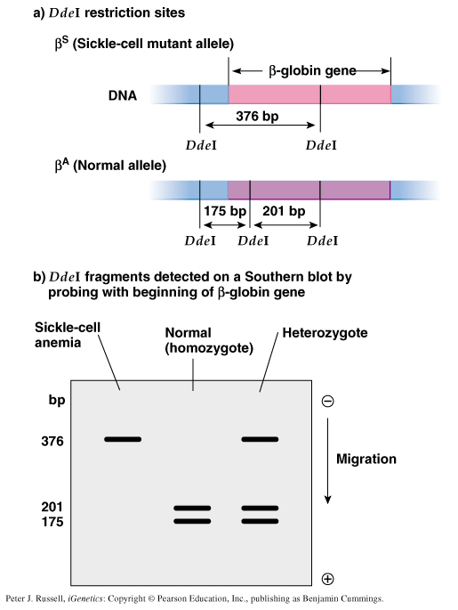
Fig. 8.5 Detection of sickle-cell gene by the DdeI restriction fragment length polymorphism
This is detection of the restricted fragments of the Hb gene by radioactive probe as shown in preceding slide 3 and 4. The technique is called southern blot. See slide 3 and 4
What does this band represent? Why it is absent in normal individuals and why it is present as a single band sickle cell individuals

Slide 10
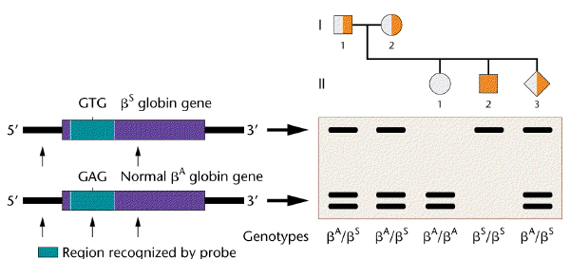
Diagnosis of Sickle-Cell Anemia Substitution by Southern Blotting
Restriction Site Lost
in Sickle Allele
Can you now see the advantages of this technique? Can the genotype of an unborn fetus be determined by this technique then? Should a sickle cell carrier couple opt for an prenatal diagnosis of their unborn fetus??

Slide 11
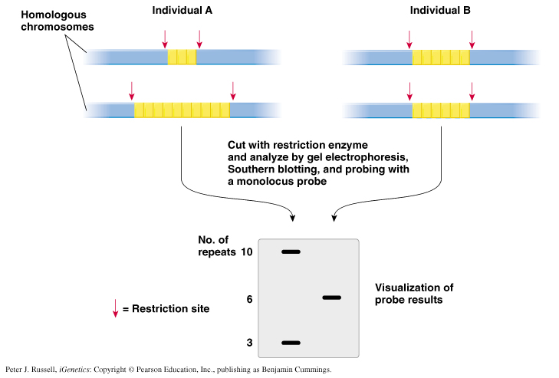
Fig. 8.9 The concept involved in using STRs (microsatellites) or VNTRs
(mini-satellites) as DNA markers
Satellite DNA consists of very large arrays of tandemly repeating, non-coding DNA.

Slide 12
DNA Typing in a Paternity Case
1. DNA typing in a paternity case would proceed as follows (Figure 8.10):
  a. DNA samples (typically from blood) are obtained from mother, baby and putative father.
  b. DNA is cut with a particular restriction enzyme, electrophoresed and transferred to a membrane filter by Southern blotting.
  c. Hybridization is performed with a labeled monolocus STR or VNTR probe, and the banding pattern is analyzed.
  d. Baby and mother are expected to share one allele, while baby and father share the other allele.
  e. If the man and baby do not share a common allele, DNA typing has proved he is not the father. If they do share an allele, paternity is possible, but not proven, since other men also carry the allele at some frequency that can be calculated.
  f. Often five or more different polymorphisms are characterized. If all match with the putative father, the combined probabilities calculated for the array of polymorphisms can be convincing evidence in court.

Slide 13
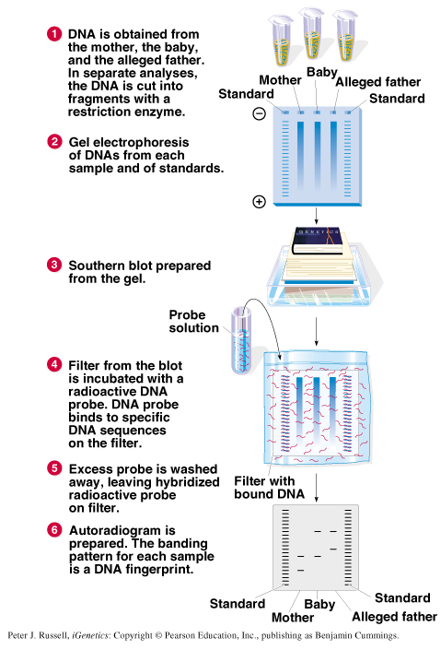
Fig. 8.10 Procedure for DNA typing as used for a paternity case
Is he the real father?

Slide 14
Other Applications of DNA Typing
1. Examples of DNA typing used to analyze present-day samples include:
  a. Forensic analysis in criminal cases. DNA samples from victims and suspects are compared, sometimes using PCR to amplify the relevant DNA.
  b. Population studies to determine variability in groups of people.
  c. Proving horse pedigrees for registration purposes.
  d. Forensic analysis in wildlife crimes, allowing body parts of poached animals to be matched and used as evidence.
  e. Detection of pathogenic E. coli strains in foods such as ground meat.
  f. Detection of genetically modified organisms (GMOs) in bulk or processed foods, by the presence of inserted sequences.

Slide 15
Gene Therapy
1. Theoretically, two types of gene therapy are possible:
  a. Somatic cell therapy, modification of non-reproductive cells to prevent a genetic disorder. Treats disease in an individual, but mutant gene can be passed to progeny.
  b. Germ-line cell therapy, altering the reproductive cells. Replaces mutant allele with a normal one, changing what offspring will inherit.
2. Somatic cell therapy is used in humans, but due to ethical issues, germ-line cell therapy is not.
3. Somatic cell therapy is most likely to be successful in disorders resulting from a simple defect in a well-understood gene.
4. The general procedure for somatic cell therapy:
  a. An individual’s mutant cells are sampled.
  b. Normal (wild-type) copies of the mutant gene are introduced into the cells.
  c. The modified cells are returned to the donor.
  d. If all goes well, cells produce a normal gene product, and disease symptoms decrease or disappear.

Slide 16
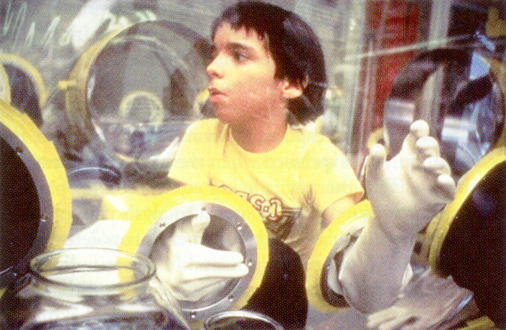
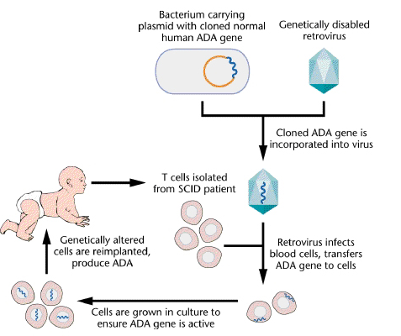
Individuals with Severe Combined Immunodeficiency (SCID) have no Functional Immune System
Gene Therapy for SCID
Homozygous for a defective ADA gene in T cells.
Bubble boy, David, lived until removed from isolation after a bone marrow transplant to restore his immune system.
Integration into chromosome

Slide 17
Commercial Products
1. Biotechnology has become big business, and one aspect of it is manipulation of DNA to make commercial products. The general approach is to:
  a. Express a cloned gene in a transformed organism using an expression vector appropriate to the host organism (which can range from bacterium to mammal).
  b. In mammals, proteins are relatively easy to isolate if secreted into milk (Figure 8.11):
    i. Gene of interest (GOI) is placed next to a promoter active only in mammary tissue (e.g., β-lactoglobin).
    ii. Recombinant DNA is microinjected into ova, and each ovum implanted into a foster mother.
    iii. At maturity, the b-lactoglobin promoter is activated, and the GOI is expressed.
    v. Product of interest is obtained from milk.

Slide 18
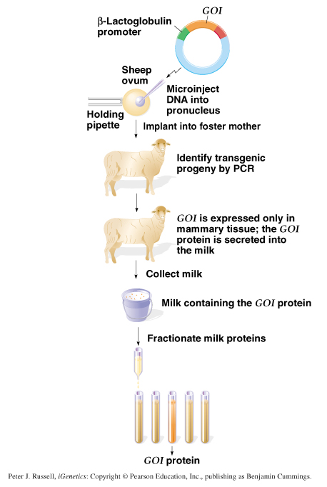
Fig. 8.11 Production of a recombinant protein product (here the protein encoded by the gene of interest, GOI) in a transgenic mammal, in this case a sheep

Slide 19
Some select examples of products from biotechnology companies:
  a. Tissue plasminogen activator (TPA), used to prevent and dissolve blood clots.
  Human growth hormone, to treat pituitary dwarfism.
  Tissue growth factor-beta (TGF-β), to promote blood vessel and epidermal growth, and thus healing.
  Human blood clotting factor VIII, to treat hemophilia.
  Human insulin (“humulin”), to treat insulin-dependent diabetes.
  Recombinant vaccines, to prevent human and animal viral diseases.
  Bovine growth hormone, to increase meat and dairy yields.
  Platelet derived growth factor (PDGF), to treat skin ulcers in diabetics
  Genetically engineered bacteria to produce industrial enzymes, flavorings and ethanol.
  Genetically engineered bacteria specialized to degrade pollutants.

Slide 20
Genetic Engineering of Plants
Humans have selectively bred plants for centuries. Now, recombinant DNA technology has made possible the genetic engineering of agricultural plants.

Slide 21
Transformation of Plant Cells
Genetic engineering is relatively difficult in plants. Most plant transformation involves the bacterium Agrobacterium tumefaciens, a plant pathogen with a wide host range.
  a. Causative agent of crown gall disease, Agrobacterium can invade most dicots at a wound site and insert a defined segment of bacterial DNA into the plant genome, producing a tumor (gall).
  b. Plant cell transformation is mediated by the Ti (tumor-inducing) plasmid, a 200-kb circular DNA. A 30-kb region of the Ti plasmid is called T-DNA because it is excised from the plasmid and transforms the plant cell.
  c. The T-DNA integrates into the plant genome, and the plant acquires its genes.
  e. The only signal required to excise, transfer and integrate the T-DNA is the flanking 25-bp repeat sequences at the borders. Any DNA placed between the border sequences will be integrated into the host genome

Slide 22
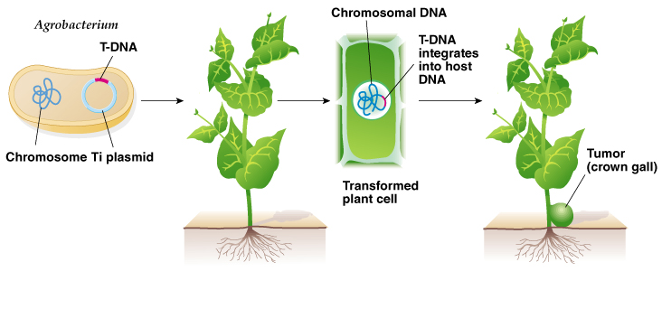
Fig. 8.12 Formation of tumors (crown galls) in plants by infection with certain species of Agrobacterium

Slide 23
2. T-DNA transformation is not effective for monocots, and so won’t work for most crop plants. In monocots, DNA is delivered into the cell by electroporation of plant cell protoplasts.
  a. DNA is added to plant cells, and high voltage is used to introduce it into the cells.
  b. Cells are tissue cultured until they recover and cell walls are. restored.
  c. Transformed cells are selected and propagated to produce whole plants.
3. DNA may also be introduced by a gene gun that fires a plastic bullet carrying tiny tungsten beads coated with DNA. At the end of the gene gun’s barrel is a plate which stops the plastic bullet but allows the tungsten beads to move into target cells, delivering the DNA.

Slide 24
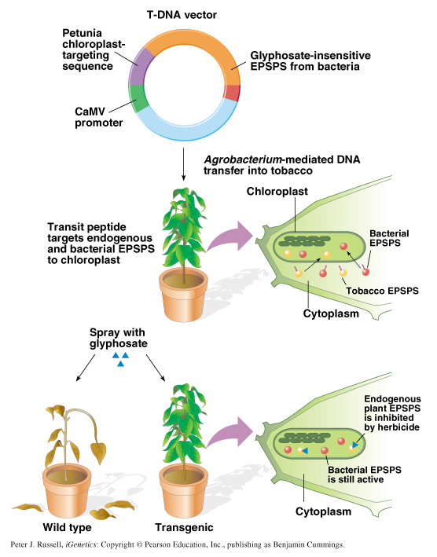
Fig. 8.13 Making a transgenic, RoundupTM-tolerant tobacco plant by introducing a modified form of the bacterial gene for the enzyme EPSPS that is resistant to the herbicide

Slide 25

Applications for Plant Genetic Engineering
1. Genetically modified crops are currently on the market and are part of our food supply. RoundupTM tolerant plants are an example.
  a. The active ingredient of RoundupTM is glyphosate, which inhibits EPSPS, a chloroplast enzyme required for aromatic amino acid synthesis.
  b. RoundupTM is active in relatively low doses, and is rapidly degraded by soil microbes.
  c. Roundup tolerant crop plants are desired because weeds can be killed by application of the herbicide, without harming the crop.

Slide 26
2. Another example is the “Flavr Savr” tomato, in which production of the fruit-softening enzyme polygalactouronase (PG) is inhibited by an antisense mRNA, resulting in vine-ripened tomatoes that are less prone to bruising and over-ripening.
3. Genetic engineering of plants is likely to increase. Particularly valuable traits might be:
  a. Increased yield.
  b. Insect pest resistance.
  c. Herbicide tolerance.
4. Developers of such plants promise advances in preventing world hunger, but significant public resistance to genetically modified plants exists in many countries, including a growing resistance in the U.S.

